Slide 1
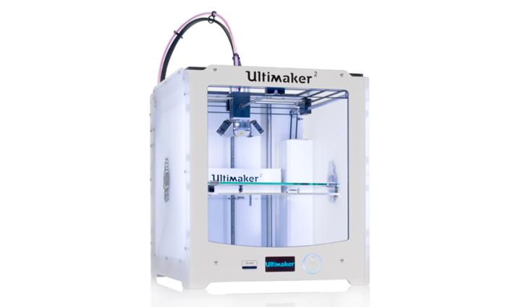
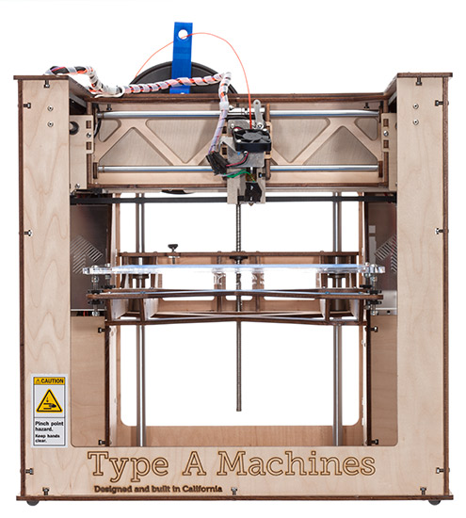
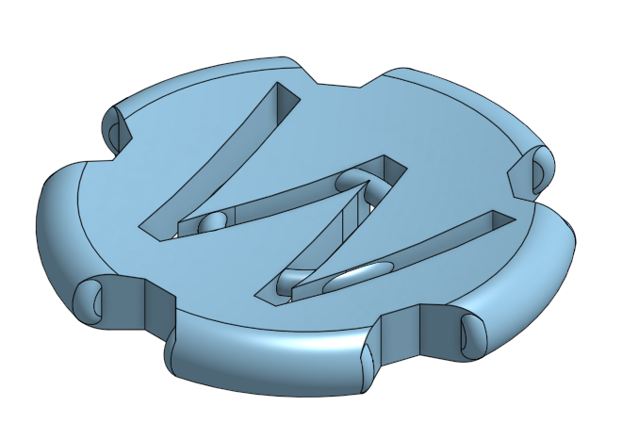
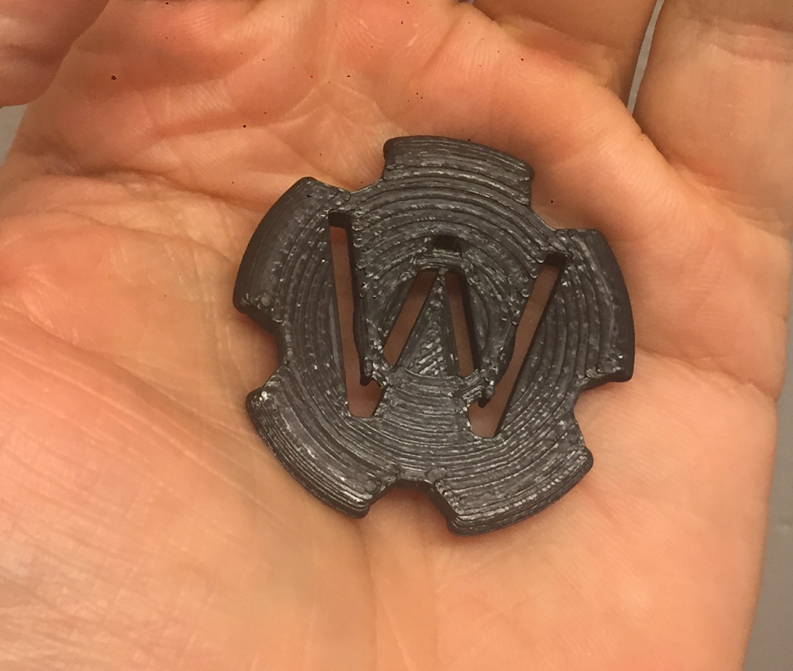
Westerdals
Introduction to 3D printing
jakob.a.nilsson@gmail.com

Slide 2

Ultimaker Cura 3D printing software
Download, install and start from here:
https://ultimaker.com/en/products/ultimaker-cura-software
Or just google: cura + download.
There is also a getting started manual on their site.

Slide 3
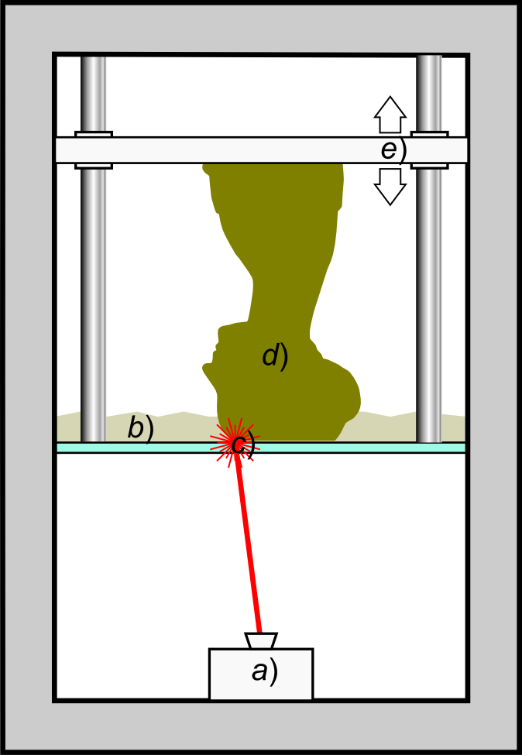
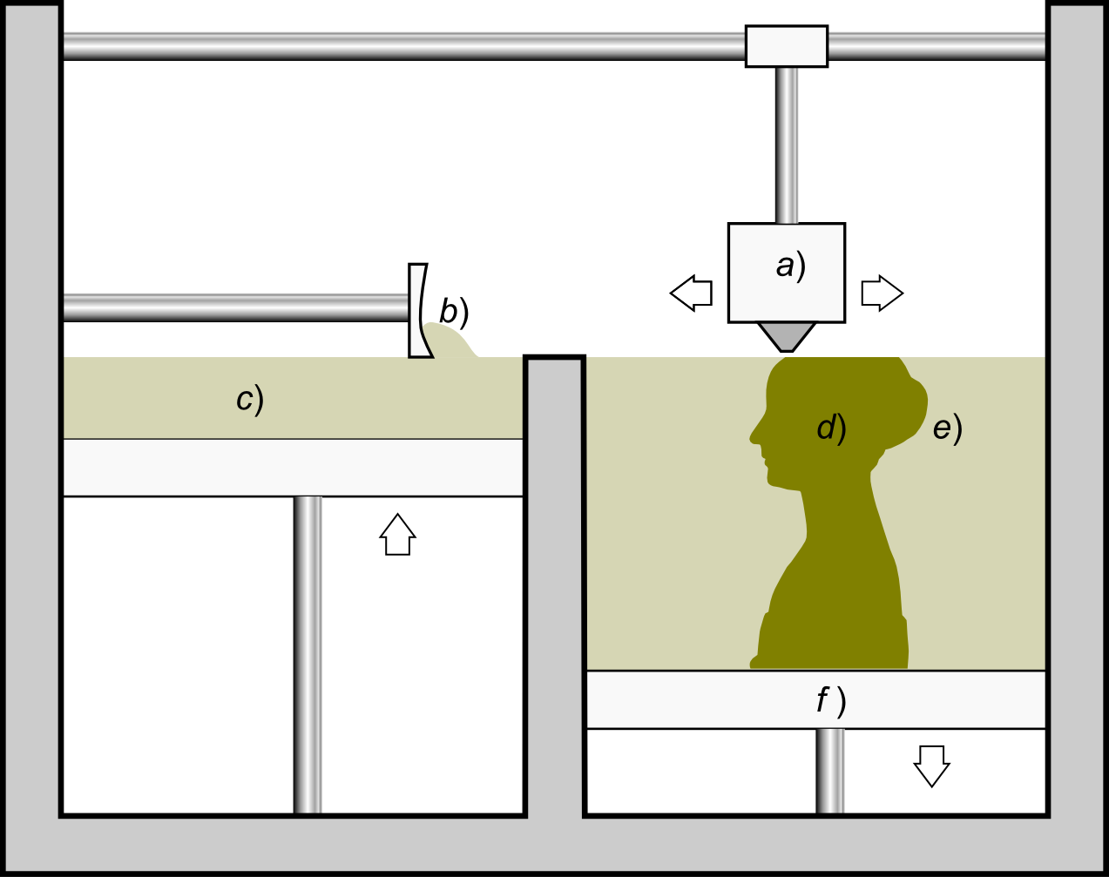
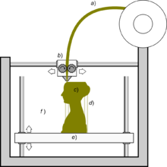
What is 3D printing?
Fused filament fabrication Stereolithography Powder Bed
Aka FDM Fused deposition modeling TM
images from:
Scopigno R., Cignoni P., Pietroni N., Callieri M., Dellepiane M. (2017). "Digital Fabrication Techniques for Cultural Heritage: A Survey". Computer Graphics Forum 36 (1): 6–21. DOI:10.1111/cgf.12781.
Notes:
images from:
Scopigno R., Cignoni P., Pietroni N., Callieri M., Dellepiane M. (2017). "Digital Fabrication Techniques for Cultural Heritage: A Survey". Computer Graphics Forum 36 (1): 6–21. DOI:10.1111/cgf.12781.

Slide 4
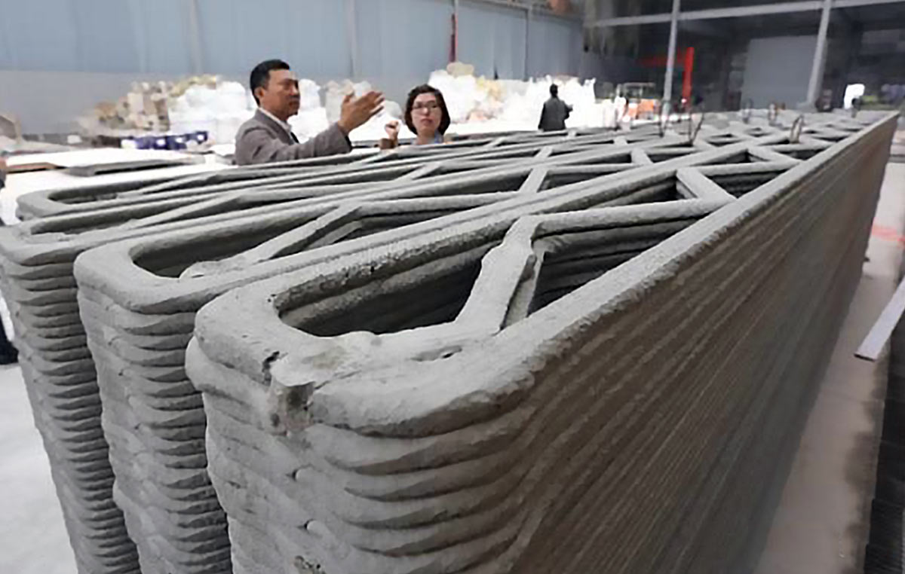
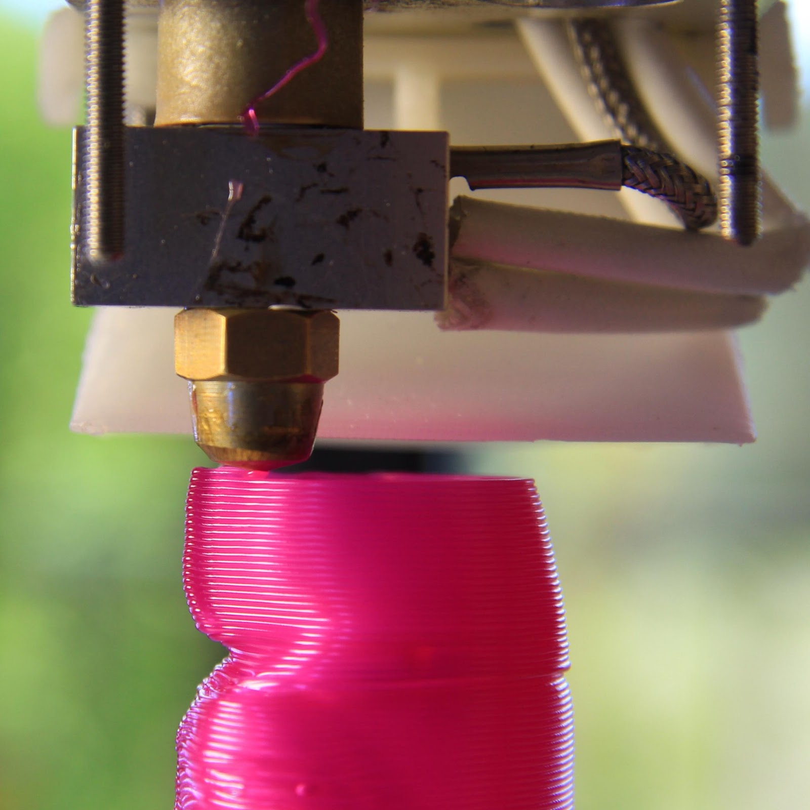
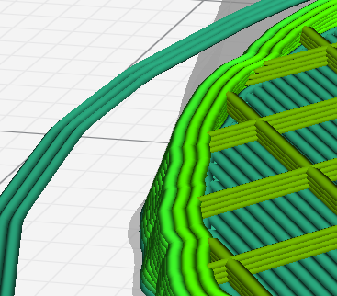
What is FFF 3D printing?
Fused filament fabrication
Additive manufacturing
Computer controlled
Layer by layer
Uses slicing software
a apis cor
tridimake
Notes:
Layer by layer buildup of solid objects by adding material
Pics from
http://apis-cor.com/en/about/blog/3d-printing-of-houses-apis-cor
http://www.tridimake.com/2013/07/extremely-fat-extrusion-with-1-mm-nozzle.html

Slide 5
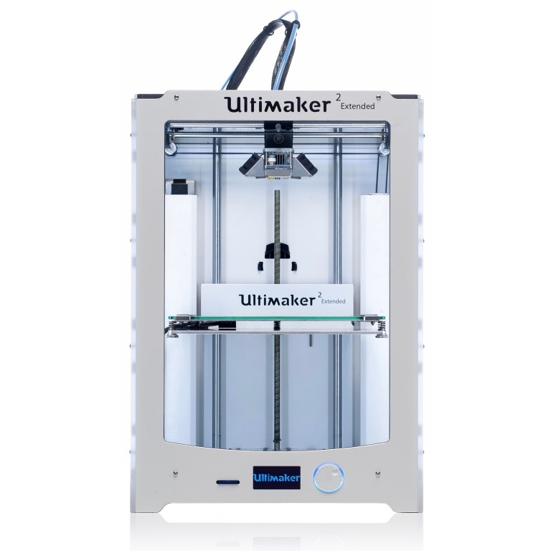
Printers at Westerdals
2x
2 x Type A Machines 1 (2013 wood edition)
Uses: 1.75 mm filament
Build volume: 26 x 23 x 24 cm
1 x Ultimaker 2+ Exended
Uses: 2.85 mm filament
Build volume: 22.3 x 22.3 x 30.5 cm
Has: Heated bed
All:
Print surface: Glass + Glue stick
Print material: PLA filament
Speed: Fast enough
Nozzle size: 0.4 mm
Control: Smart Controllers with SD Card slots
1x
https://www.3dhubs.com/3d-printers/ultimaker-2-extended

Slide 6
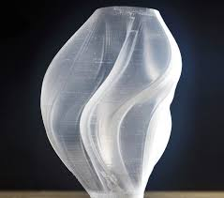
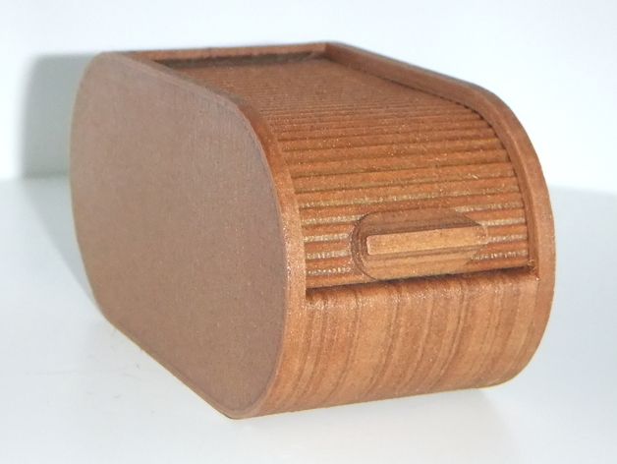
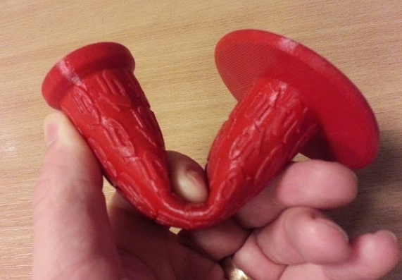
Thermoplastic printing materials (filaments)
PLA - Polylactic acid
Most common 3D printing filament!
Natural PLA is a clear polyester
Biodegradable, made from corn or sugar cane
PLA can be mixed with fillers
Metal
Gypsum
Wood
Other printing plastics include:
ABS
PETG
TPE
NYLON
link
By Fused3D
By DanielNoree
Notes:
A thermoplastic, or thermosoftening plastic, is a plastic material, a polymer, that becomes pliable or moldable above a specific temperature and solidifies upon cooling
Thermoplastic elastomers (TPE), sometimes referred to as thermoplastic rubbers, are a class of copolymers or a physical mix of polymers (usually a plastic and a rubber) which consist of materials with both thermoplastic and elastomeric properties
Dissolvable support material, dissolve with limonene…

Slide 7
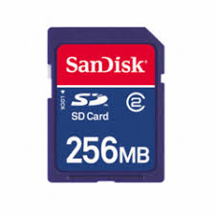
How to print a 3D model file?
Export the 3D Model (.obj or .stl file format)
Load it into the Slicer software (Cura)
Position the model (Rotate > lay flat)
Choose your printer (Ultimaker 2 or Type A Machines 1 2013)
Choose filament material (PLA)
Choose optional settings (Recommended default)
Save to SD card (.gcode)
Insert the SD card in the 3D printer
Start the job on the printer
Cura guide:
https://www.youtube.com/watch?v=RX2_e7RqUH0&t=49s (offical ulitmaker guide)
https://www.youtube.com/watch?v=N1lAwzqpXsU (Old version of cura but same principle)
Notes:
Slicer, a software that takes a 3D model, often in .obj or .stl format and slices it into layers based on the desired layer height and those are then turned into paths for the 3d printer

Slide 8
Type A Machines S1 2013 in Cura
Follow link for instructions

Slide 9
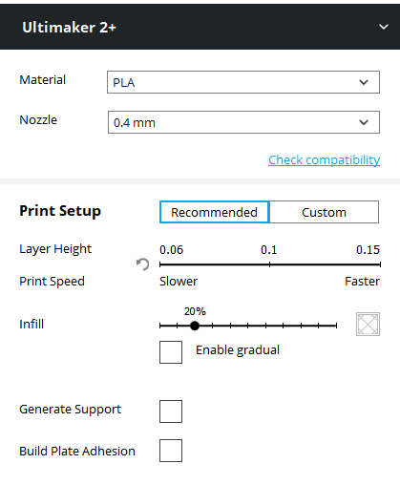
Cura settings

Slide 10
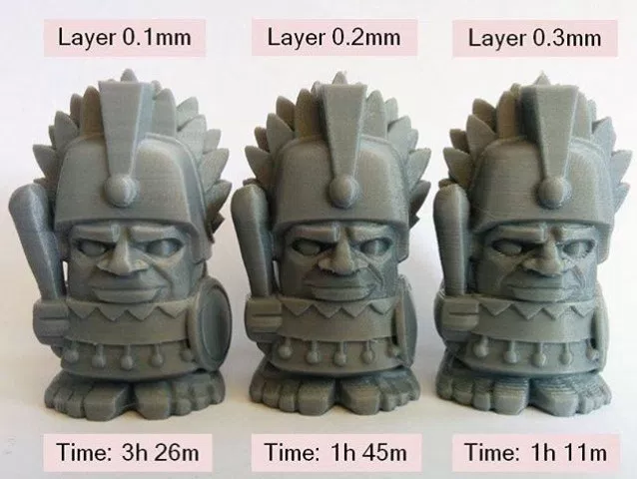
Cura settings
Layer height
Notes:
layer height https://makerlab.com.au/learn-basics-3d-printing/

Slide 11
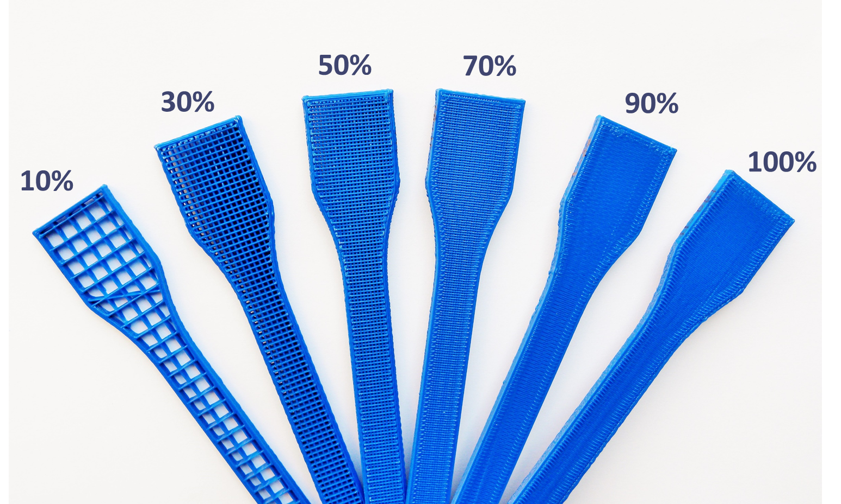
Cura settings
Infill
Notes:
Infill
http://my3dmatter.com/influence-infill-layer-height-pattern/

Slide 12
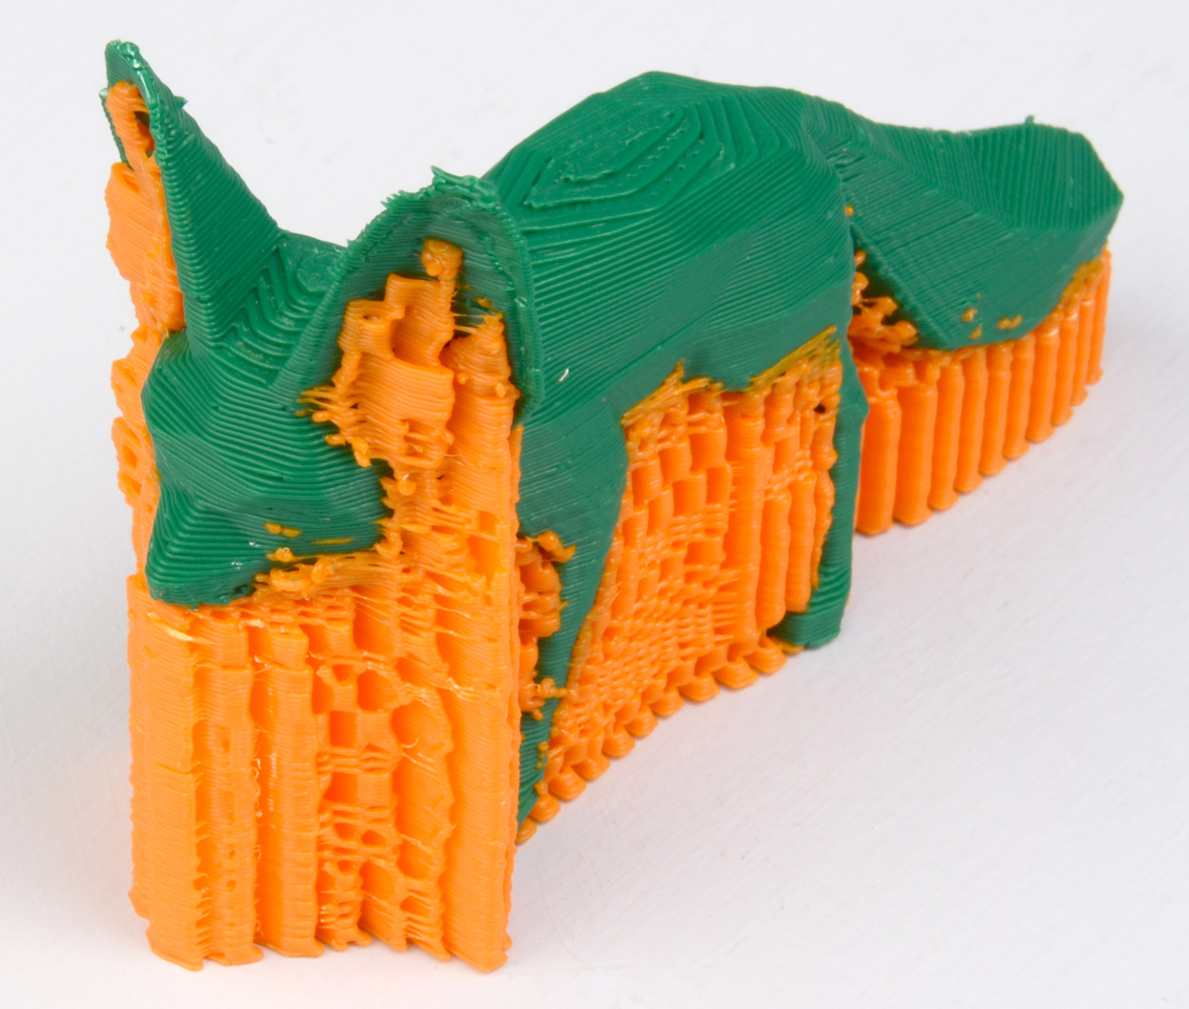
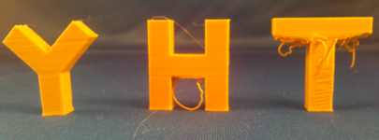
Overhang and support
Notes:
http://manual.slic3r.org/simple-mode/simple-mode
https://www.onshape.com/cad-blog/top-5-tips-for-designing-for-3d-printing

